Slide 1

Getting started…
Please sit in rows A through J only
Form groups of 3-5 students
Discuss: what questions do you have about Chapters 7-8?
Post them on Ask For Me!

Slide 2
Adding an Explanatory Variable to the Model (Continued)
Psych 100A Spring 2019
Prof. Jim Stigler

Slide 3
Up Through This Week
Explore variation
Specify models (group and regression)
Fit models (estimate parameters)
Analyze variance (partition sum of squares)
Compare complex models with empty model
SS, PRE, F

Slide 4
Today
Continue discussion of the two-group model
Partitioning scores
Partitioning sums of squares
Adding more groups to the model
Regression models
PRE, F, and df
Or, we can just answer your questions.

Slide 5
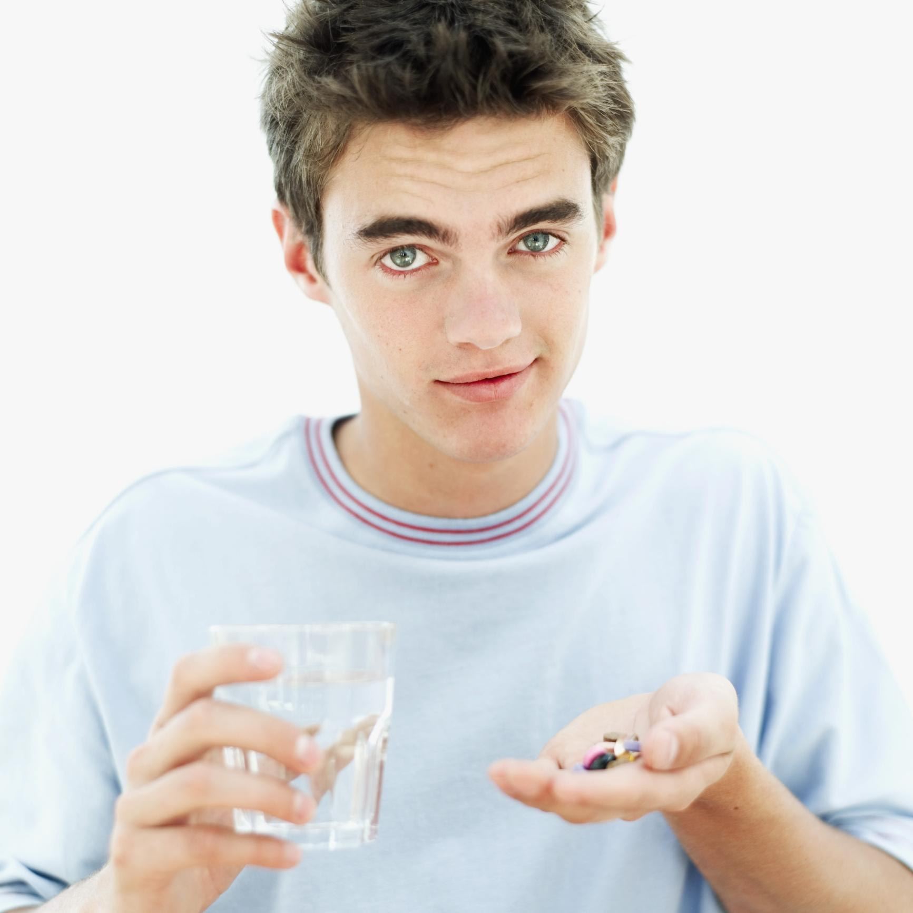
Can Respect Improve Medical Adherence?
Hypothesis: Respectful instructions will create better medical adherence
(especially in adolescents)
David S. Yeager, Quinn Hirschi, and Robert A. Josephs

Slide 6
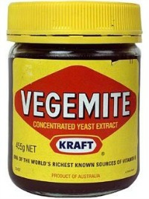
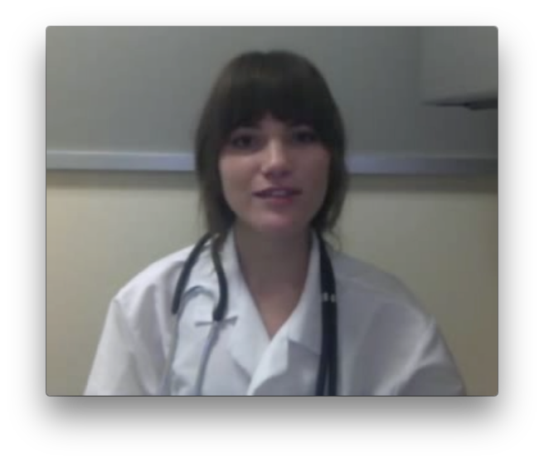
Study Procedure
0.1 g
0.4 g
Taste medicine
(spoon1)
Watch video instructions
(Respectful or Not)
How much medicine did they eat? (spoon2)
Notes:
**
As soon as participants arrived in our lab, we had them sample 0.1 gram of the Vegemite.
We wanted them to see how it tasted before beginning our experiment, and as you might have predicted, they rated it as overwhelmingly bitter and unpleasant to take.
Then, we told participants they would be participating in two separate studies that had been bundled together for the sake of time.
**
In the first study, the researchers would be measuring the effects of testosterone administration on individual attitudes and preferences.
Under the guise of this study,
We collected a baseline salivary hormone sample.
Then we had participants self administer a nasal spray that contained 14 milligrams of either testosterone or a placebo control (participants and experimenters were both blind to drug condition, and were kept blind to drug condition throughout the experiment).
As we started waiting for the drug to absorb in their system, we had participants complete a few questionnaires.
**
After participants completed the questionnaires, we told them they would be beginning the second study. In this study, they believed we were helping the medical school develop a new protocol to evaluate medical students.
First, participants read medical magazines to “familiarize themselves with the medical field.” In reality, they were completing an innocuous tasks while we waited exactly 45 minutes for the drug to absorb in their system.
At exactly 45 minutes, participants were randomly assigned (via a Qualtrics survey) to receive status-enhancing or status-diminishing video instructions from a medical student to take another spoonful of .4 gram of the Vegemite, which was on the table in front of them.
Immediately after receiving these instructions, participants made a real choice about whether or not to take the spoonful of Vegemite, and then they reported how respected, autonomous, competent, and high status the medical student giving them the instructions made them feel.
We assessed these feelings with 8 items – 2 items for each construct. For example, one of the items to measure respect was “The person in the video made me feel respected.”

Slide 7
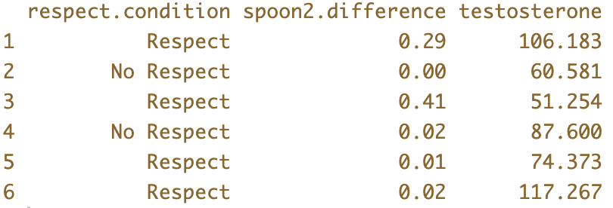
head(Vegemite.brief)

Slide 8
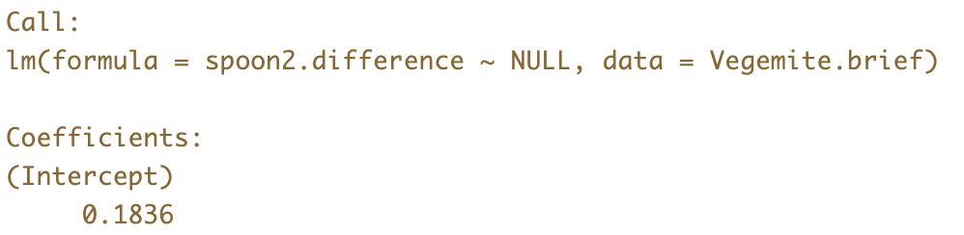
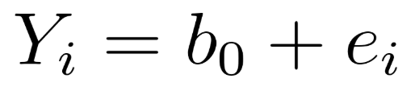
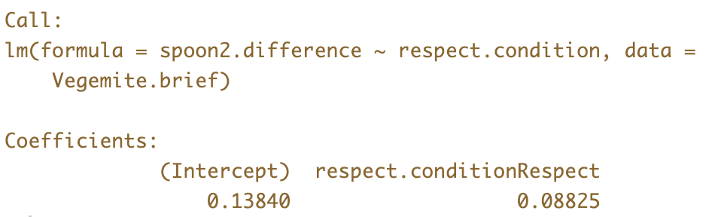
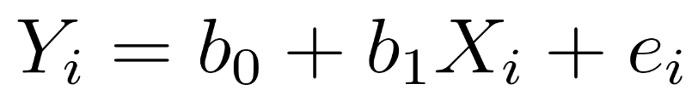
Fitting the Empty Model and the Two-Group Model
Empty
Model
Two-Group
Model

Slide 9

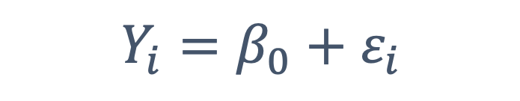
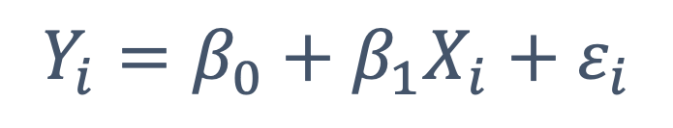
As the researcher, which parameter are we most interested in?
Empty
Model
$$Y_{i}=β_{0}+ε_{i}$$
Two-Group
Model
$$Y_{i}=β_{0}+β_{1}X_{i}+ε_{i}$$

Slide 10
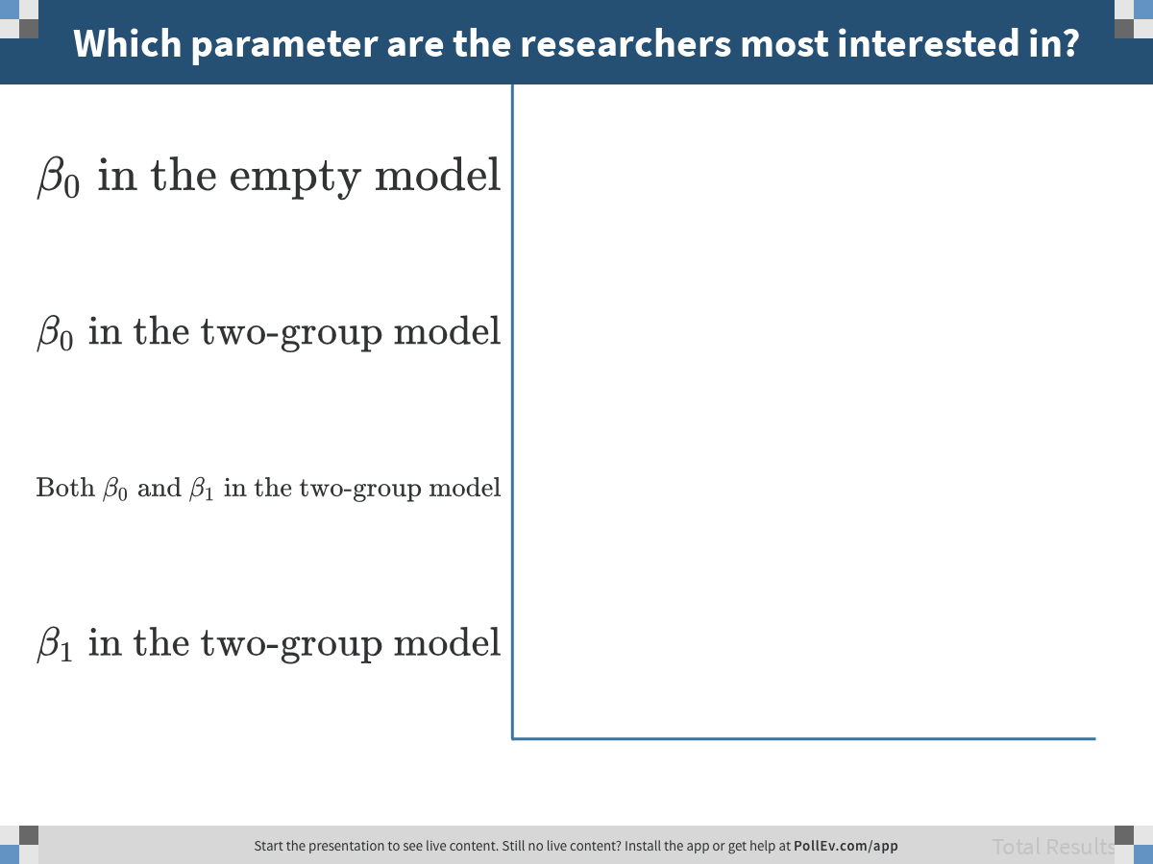
Notes:
Which parameter are the researchers most interested in?
https://www.polleverywhere.com/multiple_choice_polls/GEVIUN81yXGZEUEQ9bbYp

Slide 11
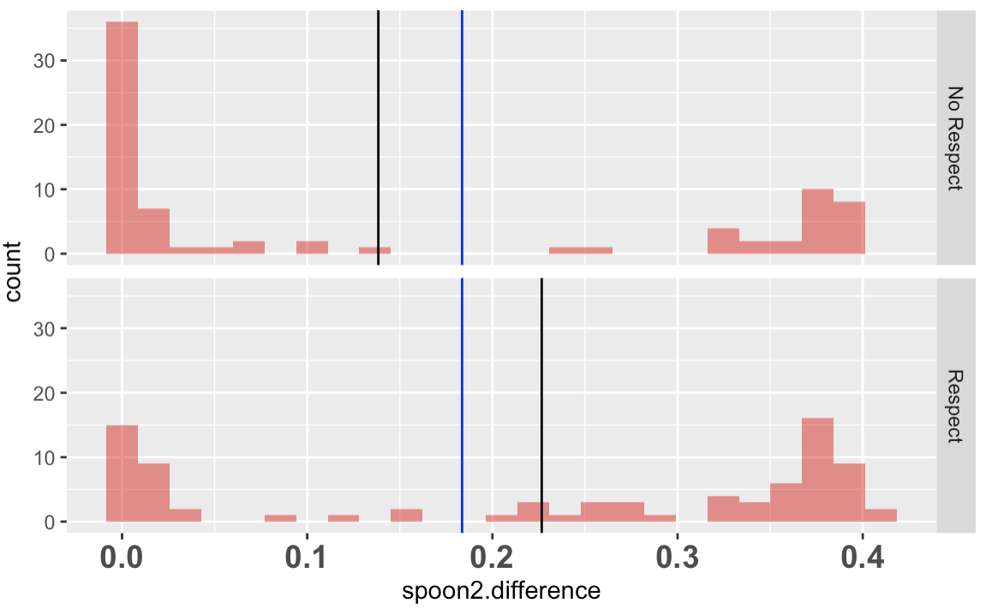
Error in the Two Models
Error at two levels: as residuals, and as totaled up in sum of squares.
A
B
B
A
SS Model
(explained)
SS Error (unexplained)
C
SS Total
C

Slide 12
Error in the Two Models
For a data point right here, which model produces a better predicted score?
Error at two levels: as residuals, and as totaled up in sum of squares.
A
B
B
A
SS Model
(explained)
SS Error (unexplained)
C
SS Total
C

Slide 13
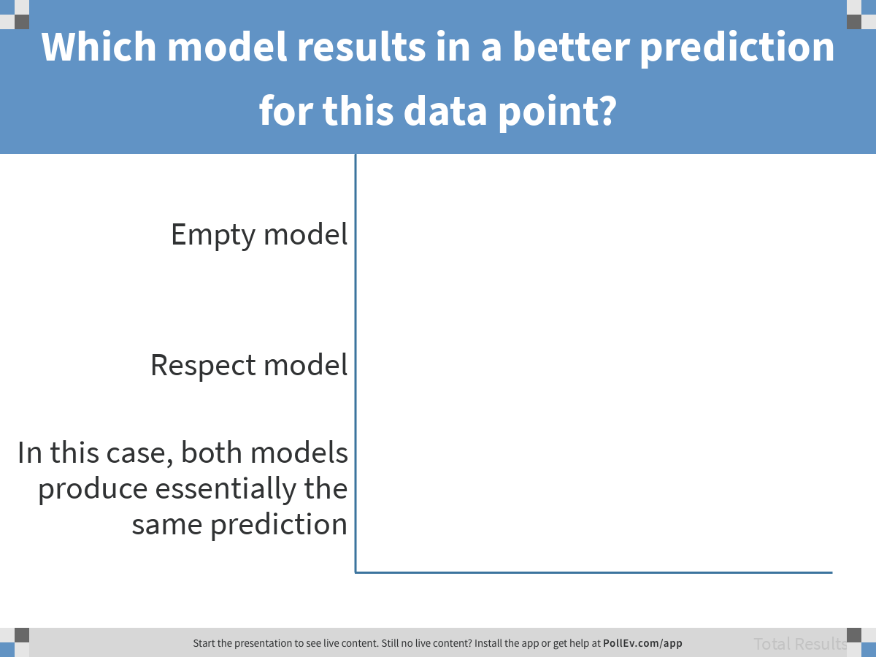
Notes:
Which model results in a better prediction for this data point?
https://www.polleverywhere.com/multiple_choice_polls/IznMOJkzuofA4wc3RRe3c

Slide 14
Error in the Two Models
For a data point right here, which model produces a better predicted score?
DATA = MODEL + ERROR
A
B
B
A
SS Model
(explained)
SS Error (unexplained)
C
SS Total
C

Slide 15
Aggregating Error to Compare Models

Slide 16
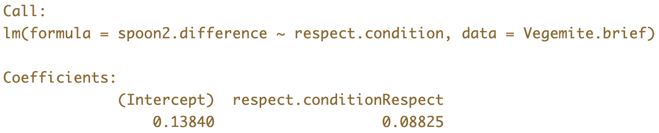
Can you tell from the model fit how much of the variation in outcome is explained?

Slide 17
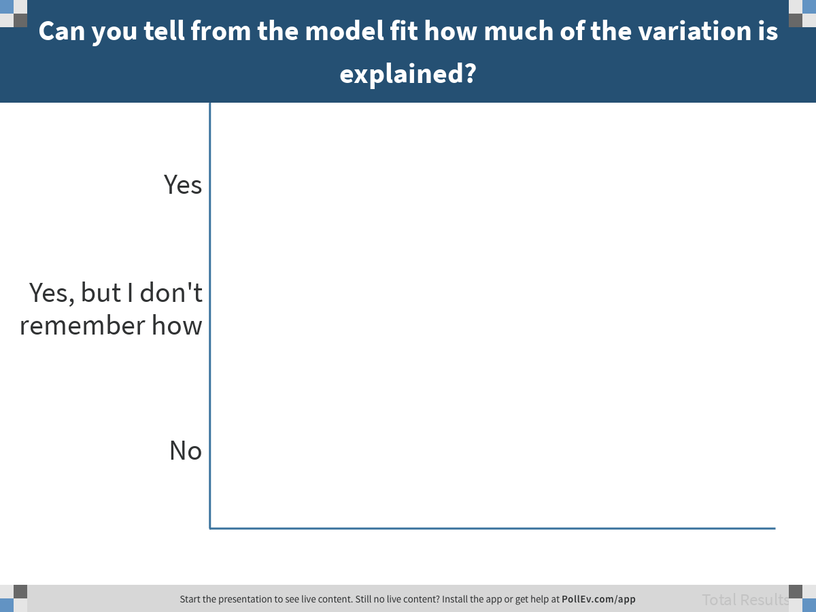
Notes:
Can you tell from the model fit how much of the variation is explained?
https://www.polleverywhere.com/multiple_choice_polls/hoEAVDbOMbUI5Slno8o7R

Slide 18
Run supernova() on both the empty.model and the respect.model.

Slide 19
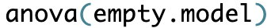
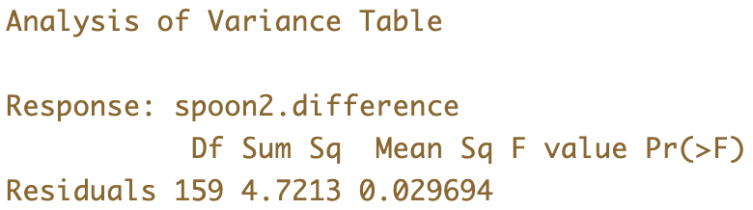
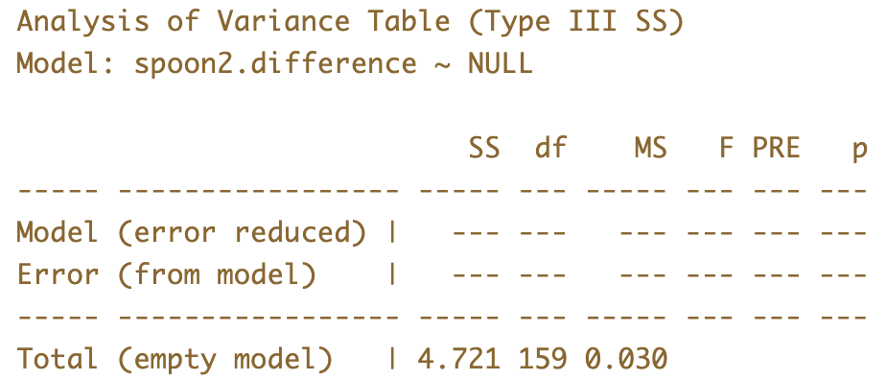
Sum of Squares: Empty Model
anova()
superanova()
The rest of the course will involve getting gaining an intimate working understanding of this table.

Slide 20
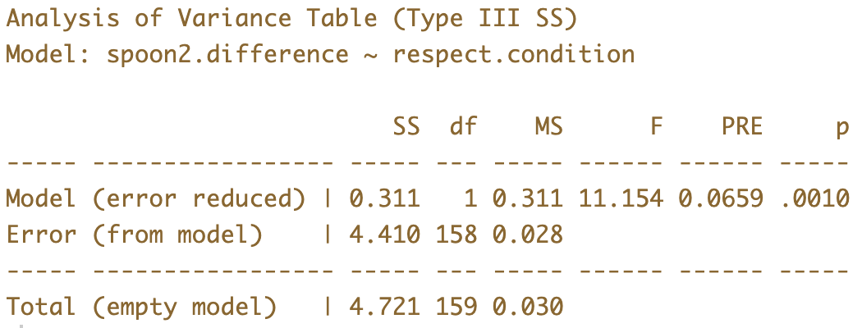

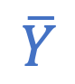
Sum of Squares: Two-Group Model
$$\hat{Y}$$
$$\overline{Y}$$

Slide 21
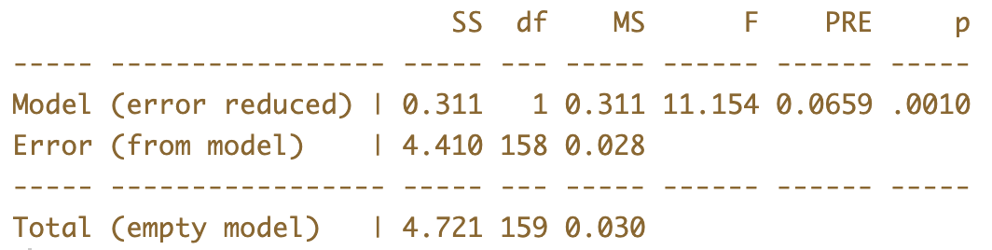
SS Model
SS Error
Group
Model
SS Total
Empty
Model
Which part represents unexplained error from the empty model?

Slide 22
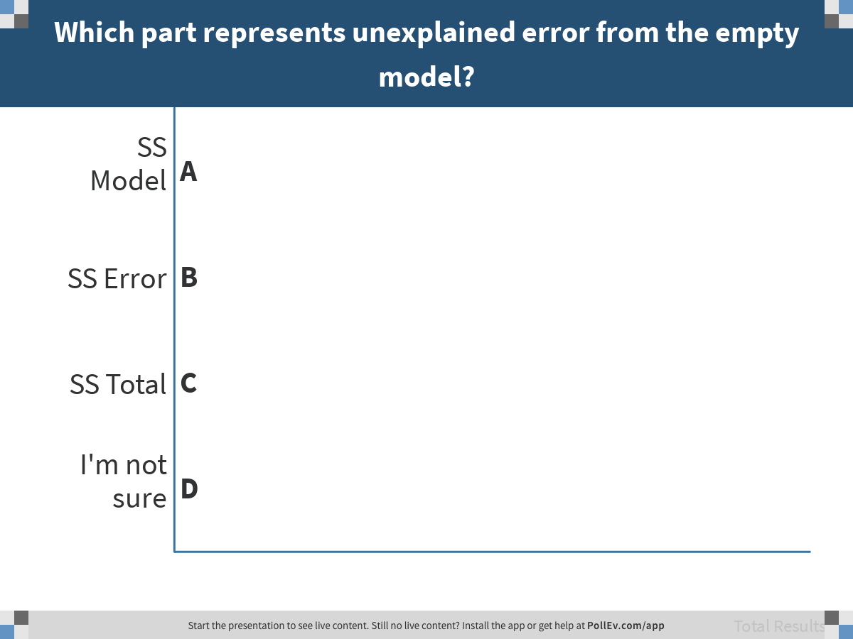
Notes:
Which part represents unexplained error from the empty model?
https://www.polleverywhere.com/multiple_choice_polls/4H7Ex0IXMU4V8I9mjhBVu

Slide 23
SS Model
SS Error
Group
Model
SS Total
Empty
Model
Partitioning Sums of Squares

Slide 24
testosterone: a three-group model

Slide 25
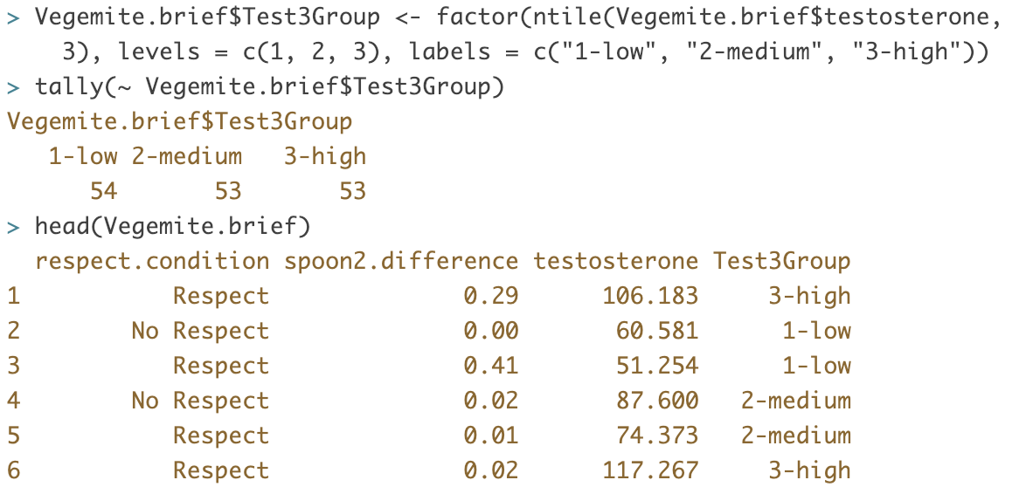
Test3Group

Slide 26
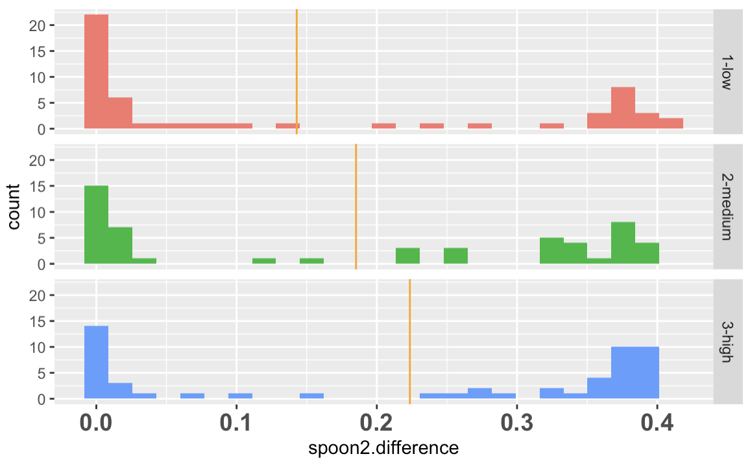
New Model for spoon2.difference: Test3Group
How would you write the model specification for the Test3Group model in GLM notation?

Slide 27
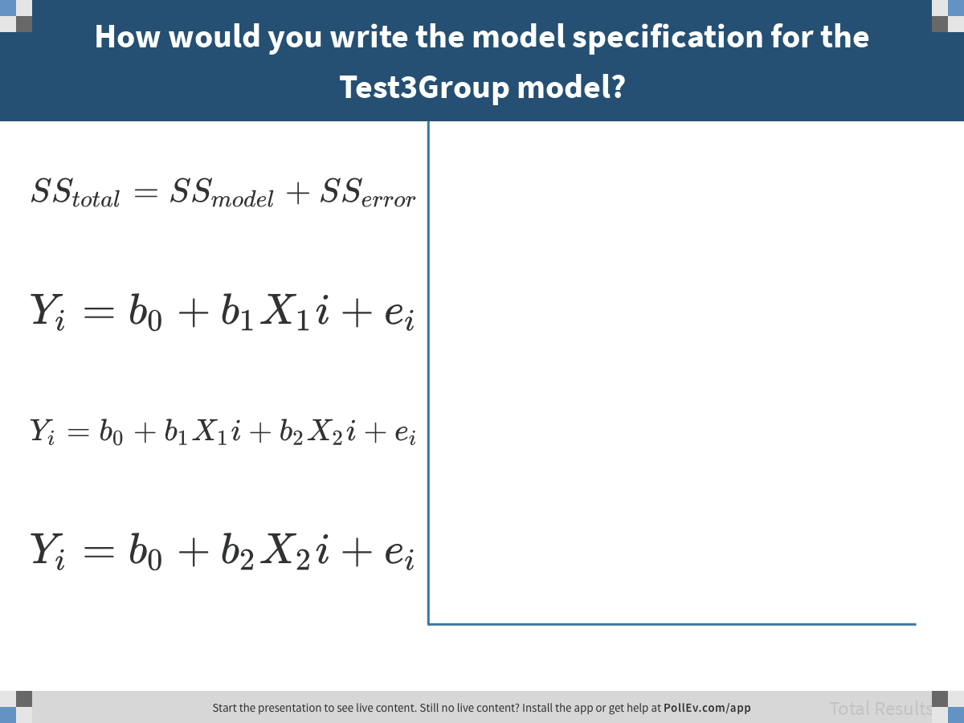
Notes:
How would you write the model specification for the Test3Group model?
https://www.polleverywhere.com/multiple_choice_polls/FQv0VawboBR3KwOCdIwuc

Slide 28
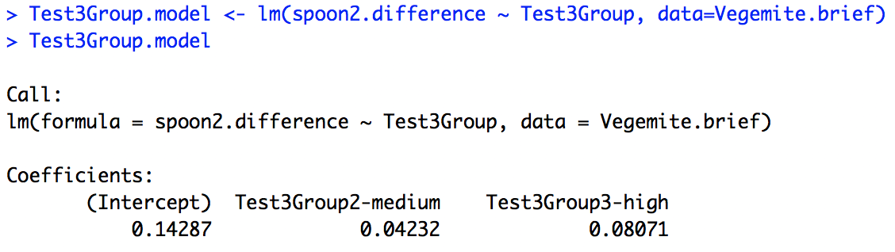
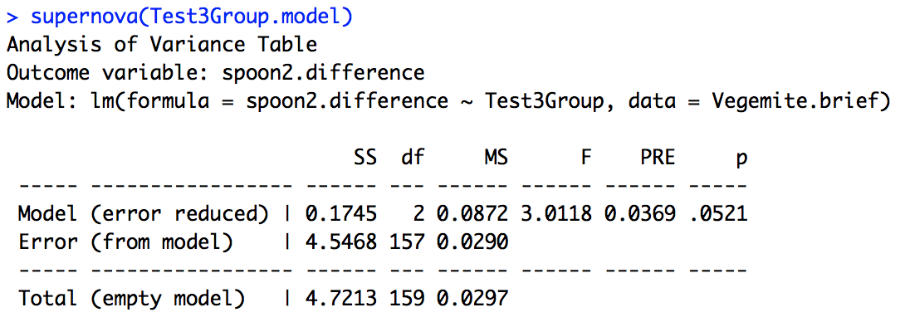
Test3Group Model
lm()
supernova()

Slide 29
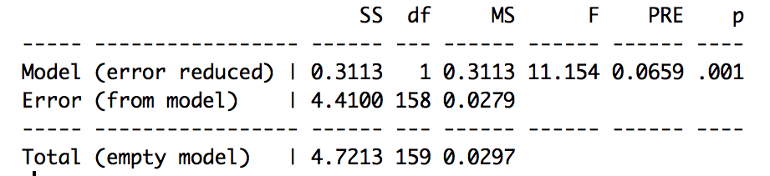
Why are SS Total the Same?
Respect
Test3Group

Slide 30
Why is PRE different?
Respect
Test3Group

Slide 31
Why are df Same for Total But Different for Model?
Respect
Test3Group

Slide 32
Comparing Models
SS Model
SS Error
Model
One
SS Model
SS Error
Model
Two
SS Total
Empty
Model
Could Model One and Model Two have different outcome variables?

Slide 33
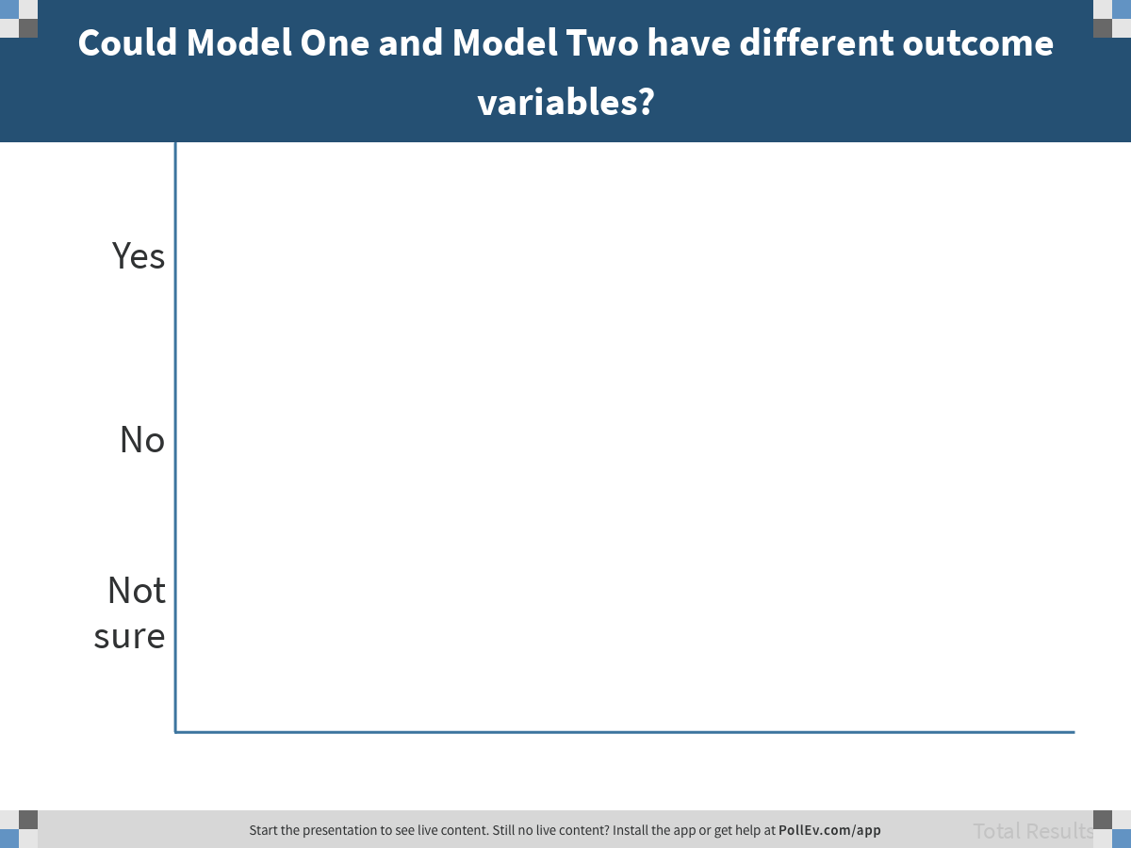
Notes:
Could Model One and Model Two have different outcome variables?
https://www.polleverywhere.com/multiple_choice_polls/g0xkz0bwgGGG2l96kkBTE

Slide 34
Comparing Models
SS Model
SS Error
Model
One
SS Model
SS Error
Model
Two
SS Total
Empty
Model
Could Model One and Model Two have different explanatory variables?

Slide 35
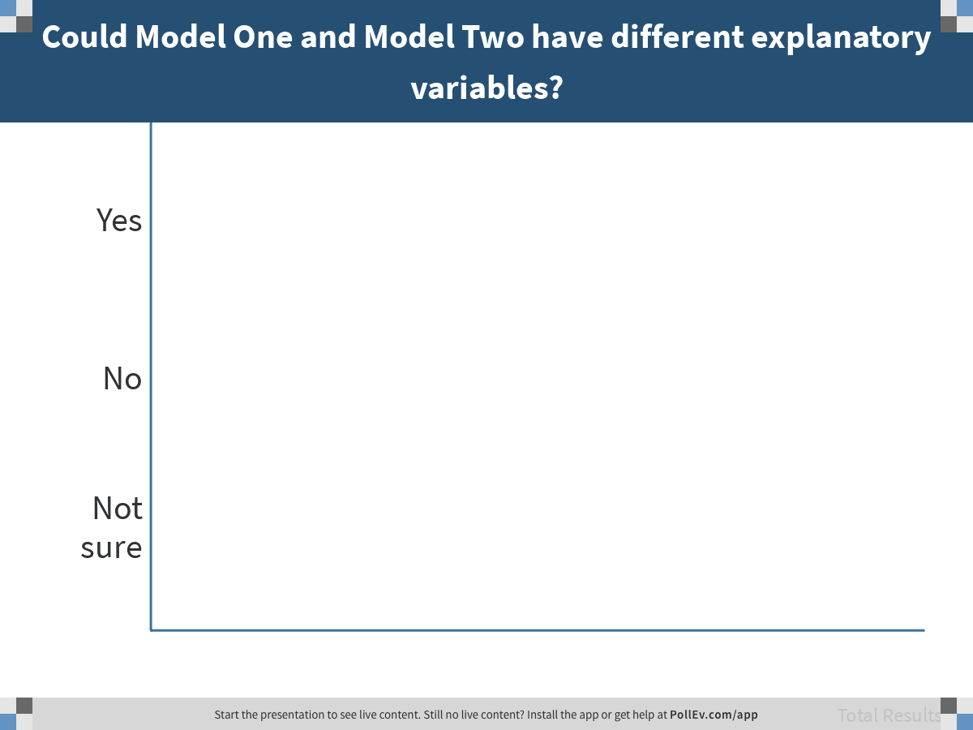
Notes:
Could Model One and Model Two have different explanatory variables?
https://www.polleverywhere.com/multiple_choice_polls/ZDfiThOgrrlB7FdGNSz7q

Slide 36
Comparing Models
SS Model
SS Error
Model
One
SS Model
SS Error
Model
Two
SS Total
Empty
Model
Could Model One and Model Two be based on different samples?

Slide 37
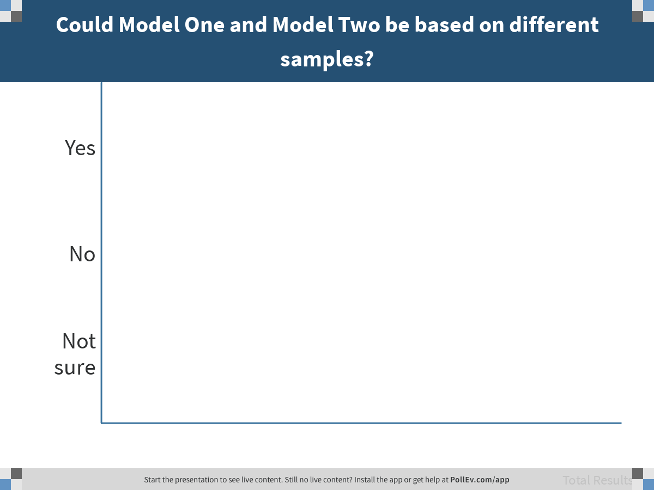
Notes:
Could Model One and Model Two be based on different samples?
https://www.polleverywhere.com/multiple_choice_polls/k3SLvoLpSFiPNeS0nECc8

Slide 38
Comparing Models with Different Outcome Variables or Samples
SS Model
SS Error
Model
One
How can you compare these two models?
SS Total
Empty
Model
SS Model
SS Error
Model
Two
SS Total
Empty
Model

Slide 39
Regression Models: SS, PRE, df, F

Slide 40
Everything you know about group models will transfer directly to regression models, with few exceptions.

Slide 41
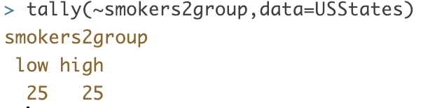
Smoking and Obesity: Comparing Two-Group and Regression Models
USStates$smokers2group <- ntile(USStates$Smokers, 2)
USStates$smokers2group <- factor(USStates$smokers2group, levels = c(1,2), labels = c("low","high"))

Slide 42
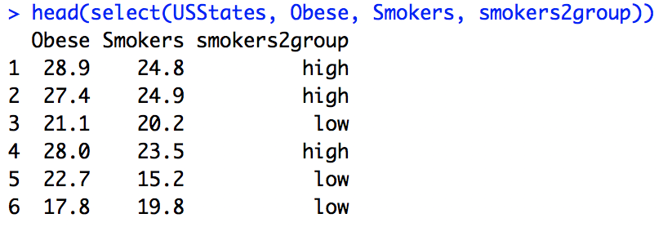
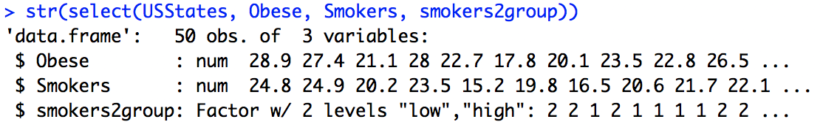
Smoking and Obesity: Comparing Two-Group and Regression Models

Slide 43
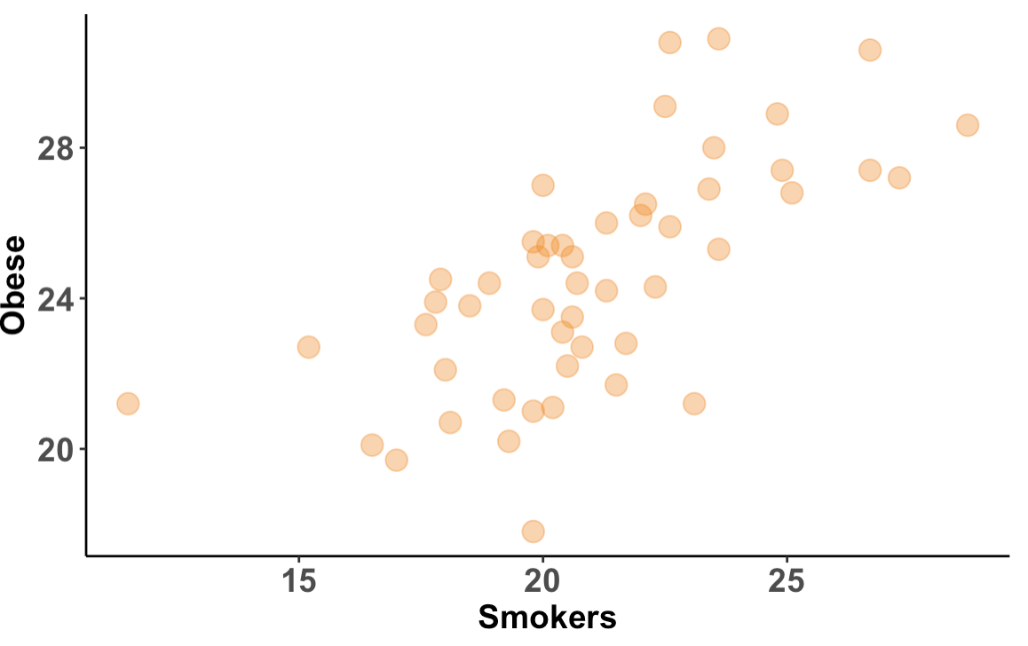
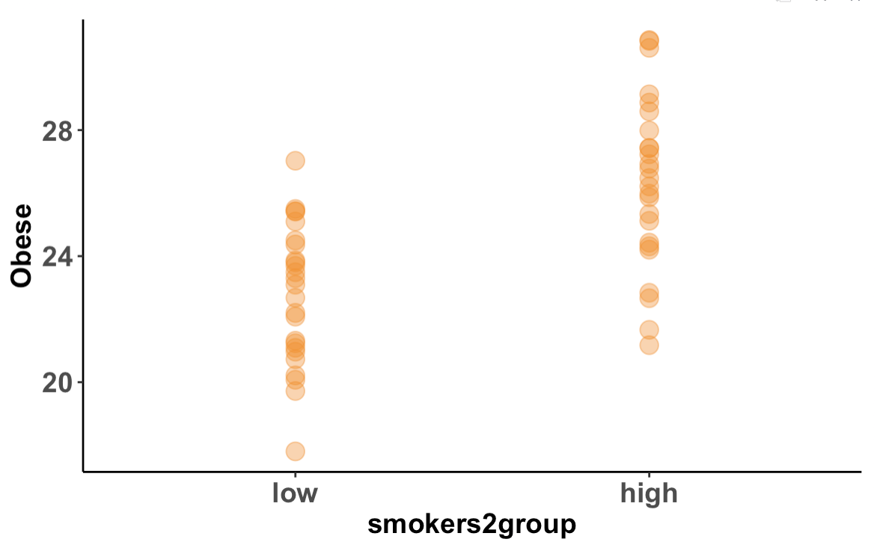
Categorical vs. Quantitative Explanatory Variable
Two-Group
Model
Regression
Model

Slide 44
Categorical vs. Quantitative Explanatory Variable
Two-Group
Model
Regression
Model
Do these two dots represent the same state?

Slide 45
Categorical vs. Quantitative Explanatory Variable
How could you divide the points in this scatter plot into the two smoker2group groups?

Slide 46
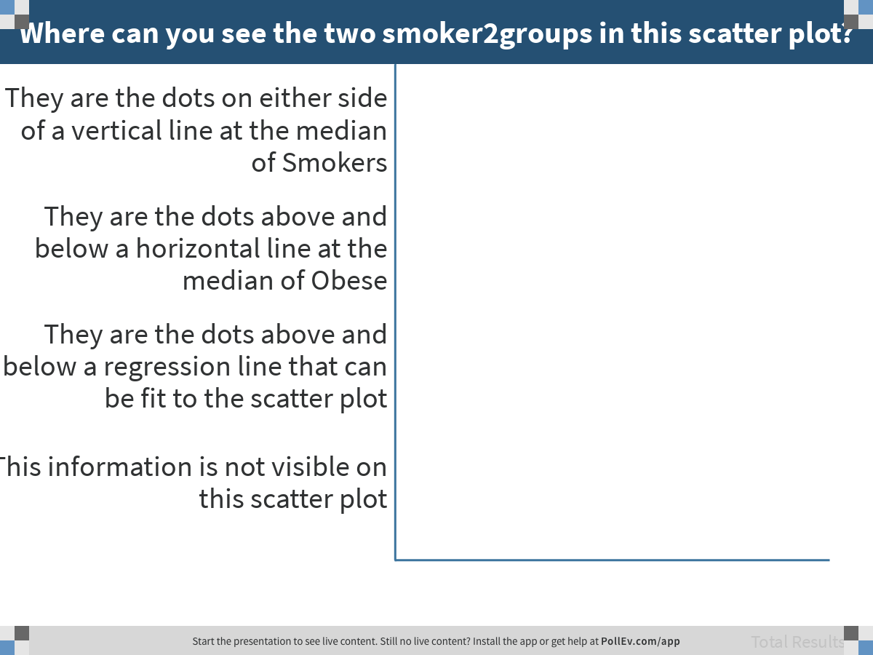
Notes:
Where can you see the two smoker2groups in this scatter plot?
https://www.polleverywhere.com/multiple_choice_polls/5fpB1wkI4Adg3jJQB9o0w

Slide 47
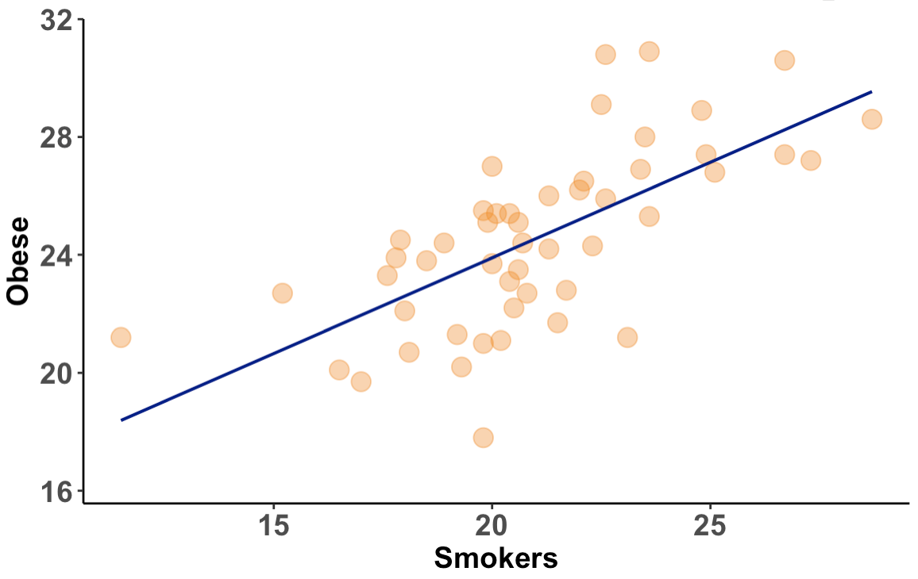
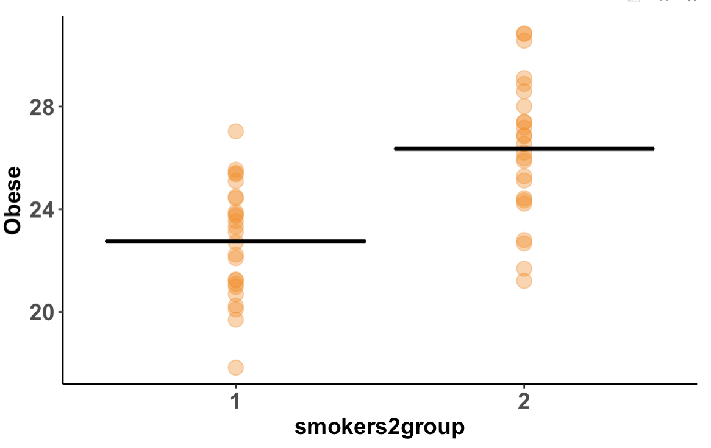
Model Predictions: Means vs. Line
Two-Group
Model
Regression
Model

Slide 48
Model Predictions: Means vs. Line
If a state has 15% smokers, what would the regression model predict their percent obese would be?

Slide 49
Model Predictions: Means vs. Line
If a state has 15% smokers, what would the regression model predict their percent obese would be?

Slide 50
Model Specification for Two-Group Model and Regression Model
Two-Group
Model
Regression
Model
How can you tell the difference? You must interpret each component
in context.

Slide 51
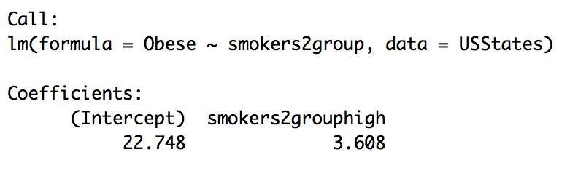
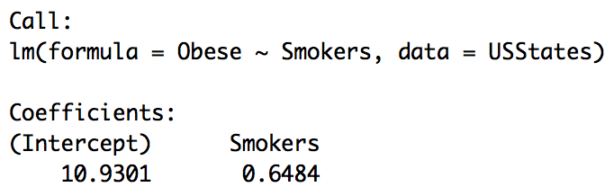
Fitting the Two-Group Model and the Regression Model: Same R Code
Two-Group
Model
Regression
Model

Slide 52
Comparing the Two-Group Model and the Regression Model
Two-Group Model
Regression Model
Why is the y intercept so much higher for the two-group model? (Think: definition of y intercept)

Slide 53
Two-Group Model
Regression Model
Two-Group
Model
Regression
Model

Slide 54
Two-Group Model
Regression Model
Why isn’t the intercept 17?
Regression
Model

Slide 55
Comparing the Two-Group Model and the Regression Model
Two-Group Model
Regression Model
Just looking at lm() output, can you tell if X is categorical or quantitative?

Slide 56
Comparing the Two-Group Model and the Regression Model
Two-Group Model
Regression Model
Why do you need to check to make sure X in the two-group model is a Factor in R?

Slide 57
Two-Group Model
Regression Model
Two-Group
Model
Regression
Model

Slide 58
Where is $\hat{Y}$ in each model?
Two-Group
Model
Regression
Model

Slide 59
How is $\hat{Y}$ different from $Y_{i}$?
How is $\hat{Y}$ different from $\overline{Y}$?

Slide 60
How is $\hat{Y}$ different from $Y_{i}$?
How is $\hat{Y}$ different from $\overline{Y}$?

Slide 61
Quantifying Error for Group Model and Regression Model
Same formula for group model and regression model; just a different $\hat{Y}.$
$$SS=Σ{{(Y}_{i}−\hat{Y})}^{2}$$
Which sum of squares is this? Total, Model, or Error?

Slide 62
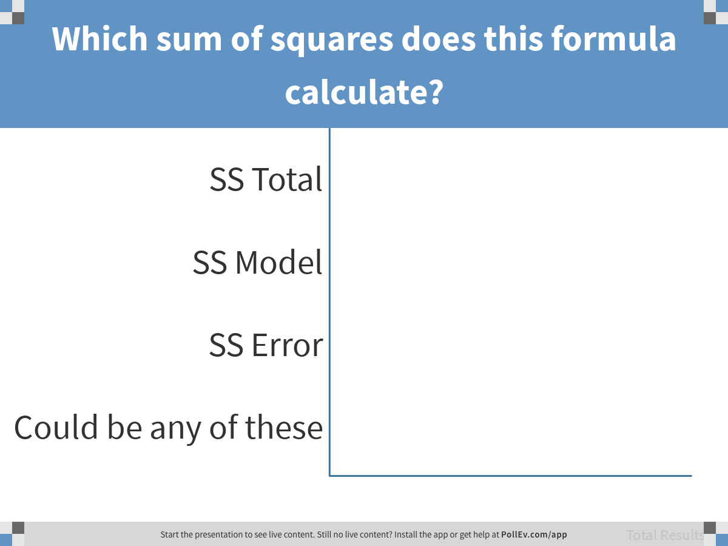
Notes:
Which sum of squares does this formula calculate?
https://www.polleverywhere.com/multiple_choice_polls/TSBmeJcblxFfChfTYXGDY

Slide 63
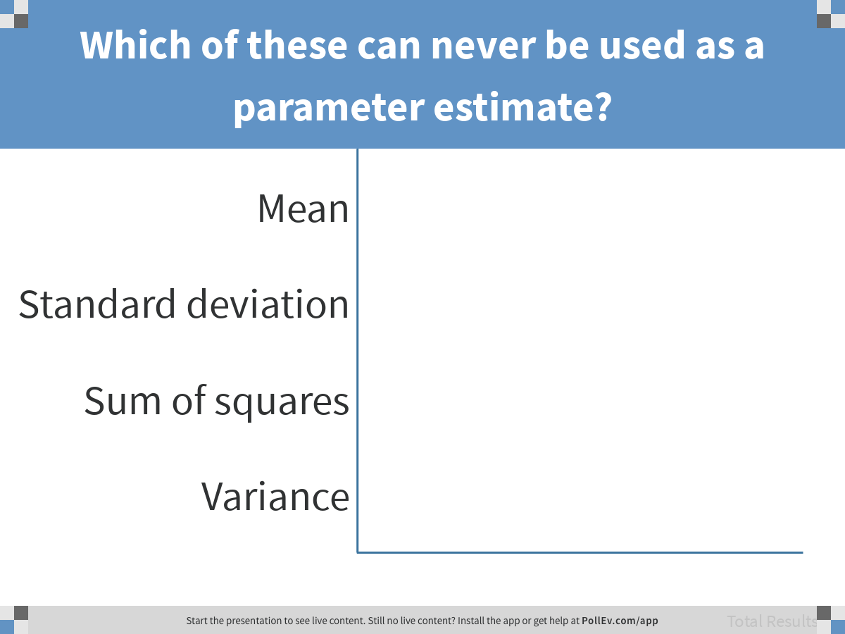
Notes:
Which of these can never be used as a parameter estimate?
https://www.polleverywhere.com/multiple_choice_polls/AuglwHlVsK3JYX5Ezgum2

Slide 64
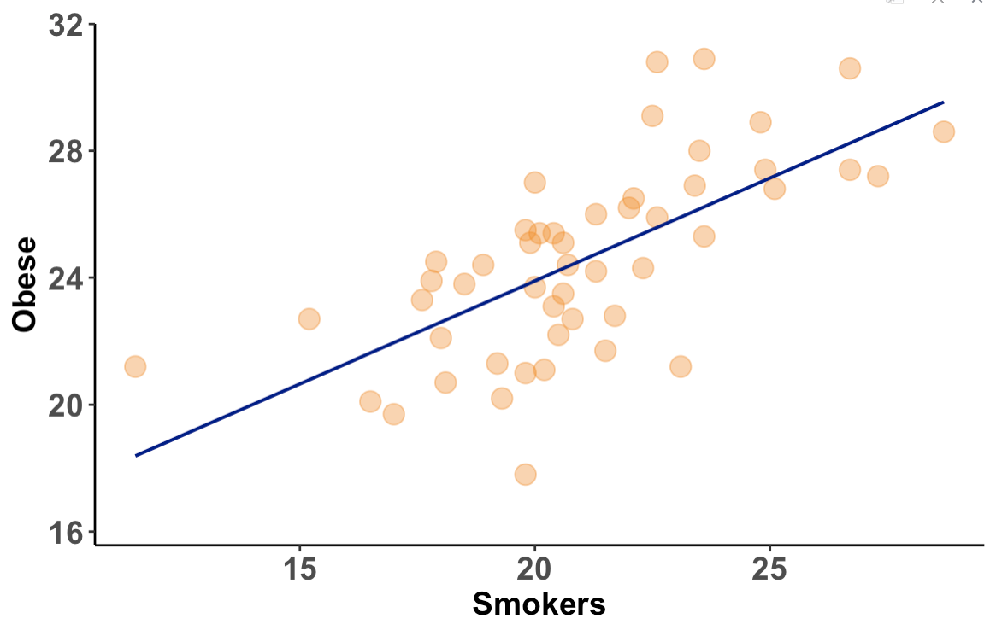
Error from Regression Model
$$\hat{Y}$$

Slide 65
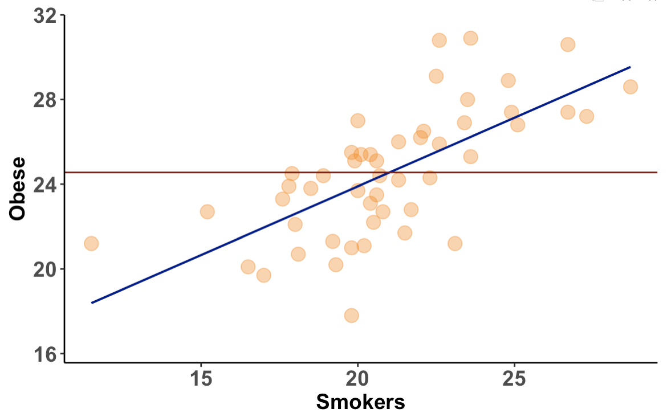
Compare to Empty Model
$$\overline{Y}$$
$$\hat{Y}$$

Slide 66
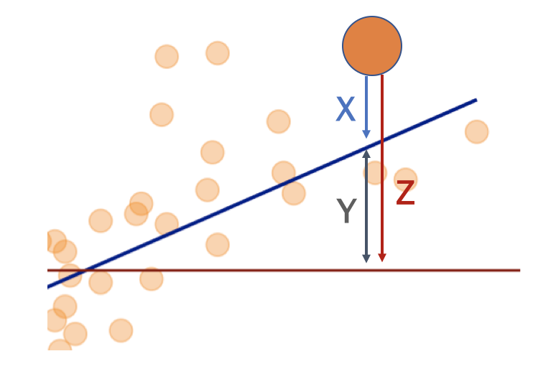
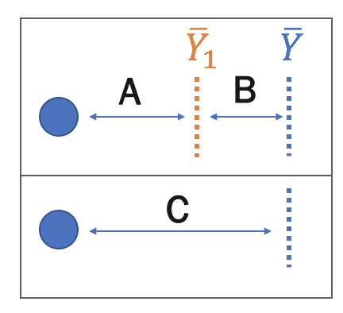
Partitioning the Residuals
Regression
Model
Group
Model
Map A, B, C to X, Y, Z

Slide 67
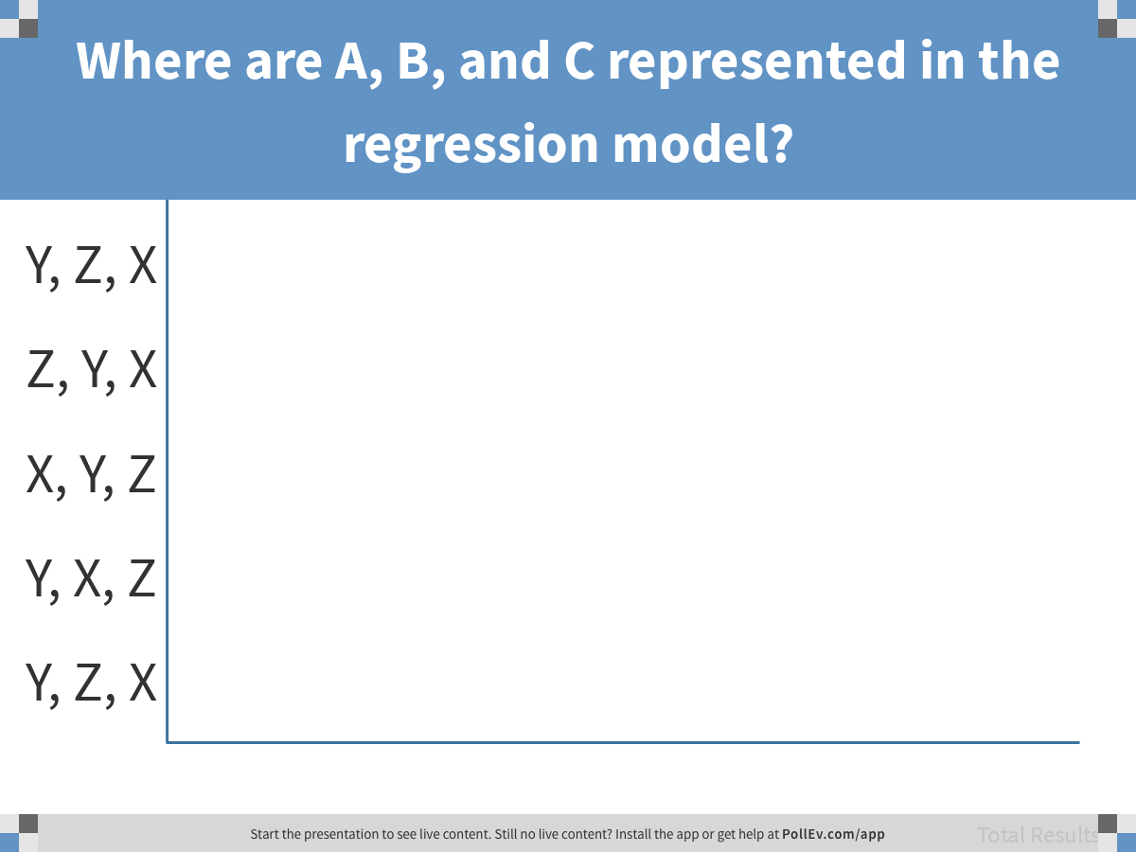
Notes:
Where are A, B, and C represented in the regression model?
https://www.polleverywhere.com/multiple_choice_polls/OepNiZlRtfNTfByUcgghA

Slide 68
Partitioning the Residuals
Regression
Model
Group
Model
Map A, B, C to X, Y, Z

Slide 69
Partitioning the Residuals
Regression
Model
Which residual is used to calculate SS Error for the regression model?
Group
Model

Slide 70
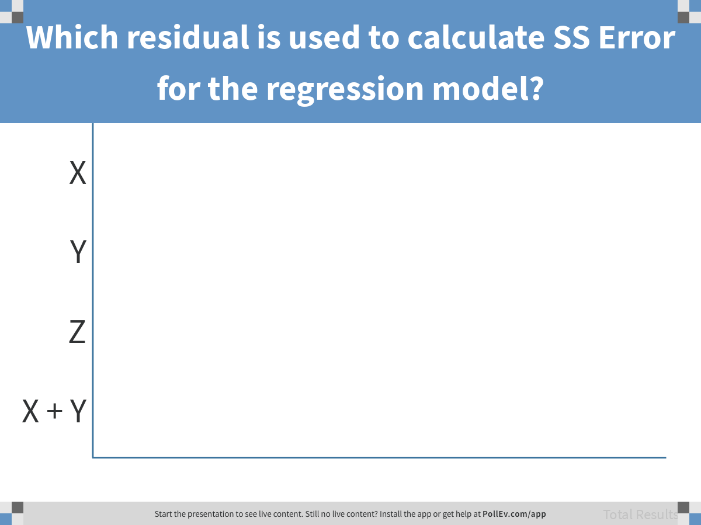
Notes:
Which residual is used to calculate SS Error for the regression model?
https://www.polleverywhere.com/multiple_choice_polls/oIGlM12XHp3iAXjEoxL6o

Slide 71
The mean ($\hat{Y}$ for the group model) minimizes SS Error within each group compared to any other number; residuals sum to 0
Two-Group
Model

Slide 72
Similarly, the regression line ($\hat{Y}$ for the regression model) minimizes SS compared to any other line; and residuals add to 0.
Regression
Model

Slide 73
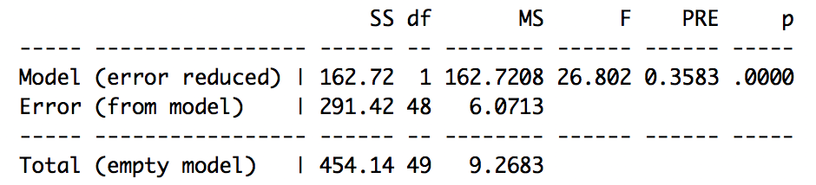

supernova: Regression Model
Two-Group Model
Regression Model
Why does df stay the same when Smokers could take so many more values in the regression model?

Slide 74
supernova: Regression Model
Two-Group Model
Regression Model
Does it make sense to compare the regression model and the group model using PRE?

Slide 75
Comparing Models
Two-Group Model
SS Model
SS Error
Regression Model
SS Model
SS Error
Empty
Model
SS Total
Could you also just compare SS Model?

Slide 76
Five Groups, Ten Groups, PRE, and F

Slide 77

Five-Group Model
We used this R command:
USStates$smokers5group <- ntile(USStates$Smokers, 5)
How many data points will be each group?

Slide 78
Five-Group Model
What does it mean to fit the five-group model?

Slide 79

Five-Group Model
What R code would fit the five-group model?

Slide 80

supernova: Five-Group Model
Two-Group Model
Five-Group Model

Slide 81

Ten-Group Model
Notice the incremental pattern is gone. What do you think will happen to PRE?

Slide 82

supernova: Five-Group Model
Five-Group Model
Ten-Group Model

Slide 83

The F Ratio
$$\frac{{MS}_{Model}}{{MS}_{Error}}$$
$$\frac{PRE \text{/} (P−1)}{(1−PRE) \text{/ (}\text{n}\text{−}\text{P}\text{)}}$$
Two formulas for F
Strength of model per degree of freedom

